Slide 1
Magic Angle
by:Mert
Ustuay

Slide 2
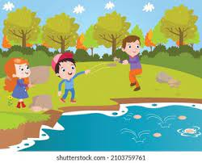
Purpose
How to throw objects farthest?
We think that to throw objects the farthest, it is enough to throw them with the strongest force however we can increase the distance by trying different angles. My purpose is to find the right angle.

Slide 3

Hypothesis
Scientists says 45 degree is the angle required to send objects to the farthest.

Slide 4
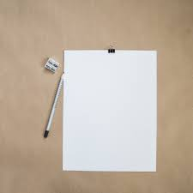
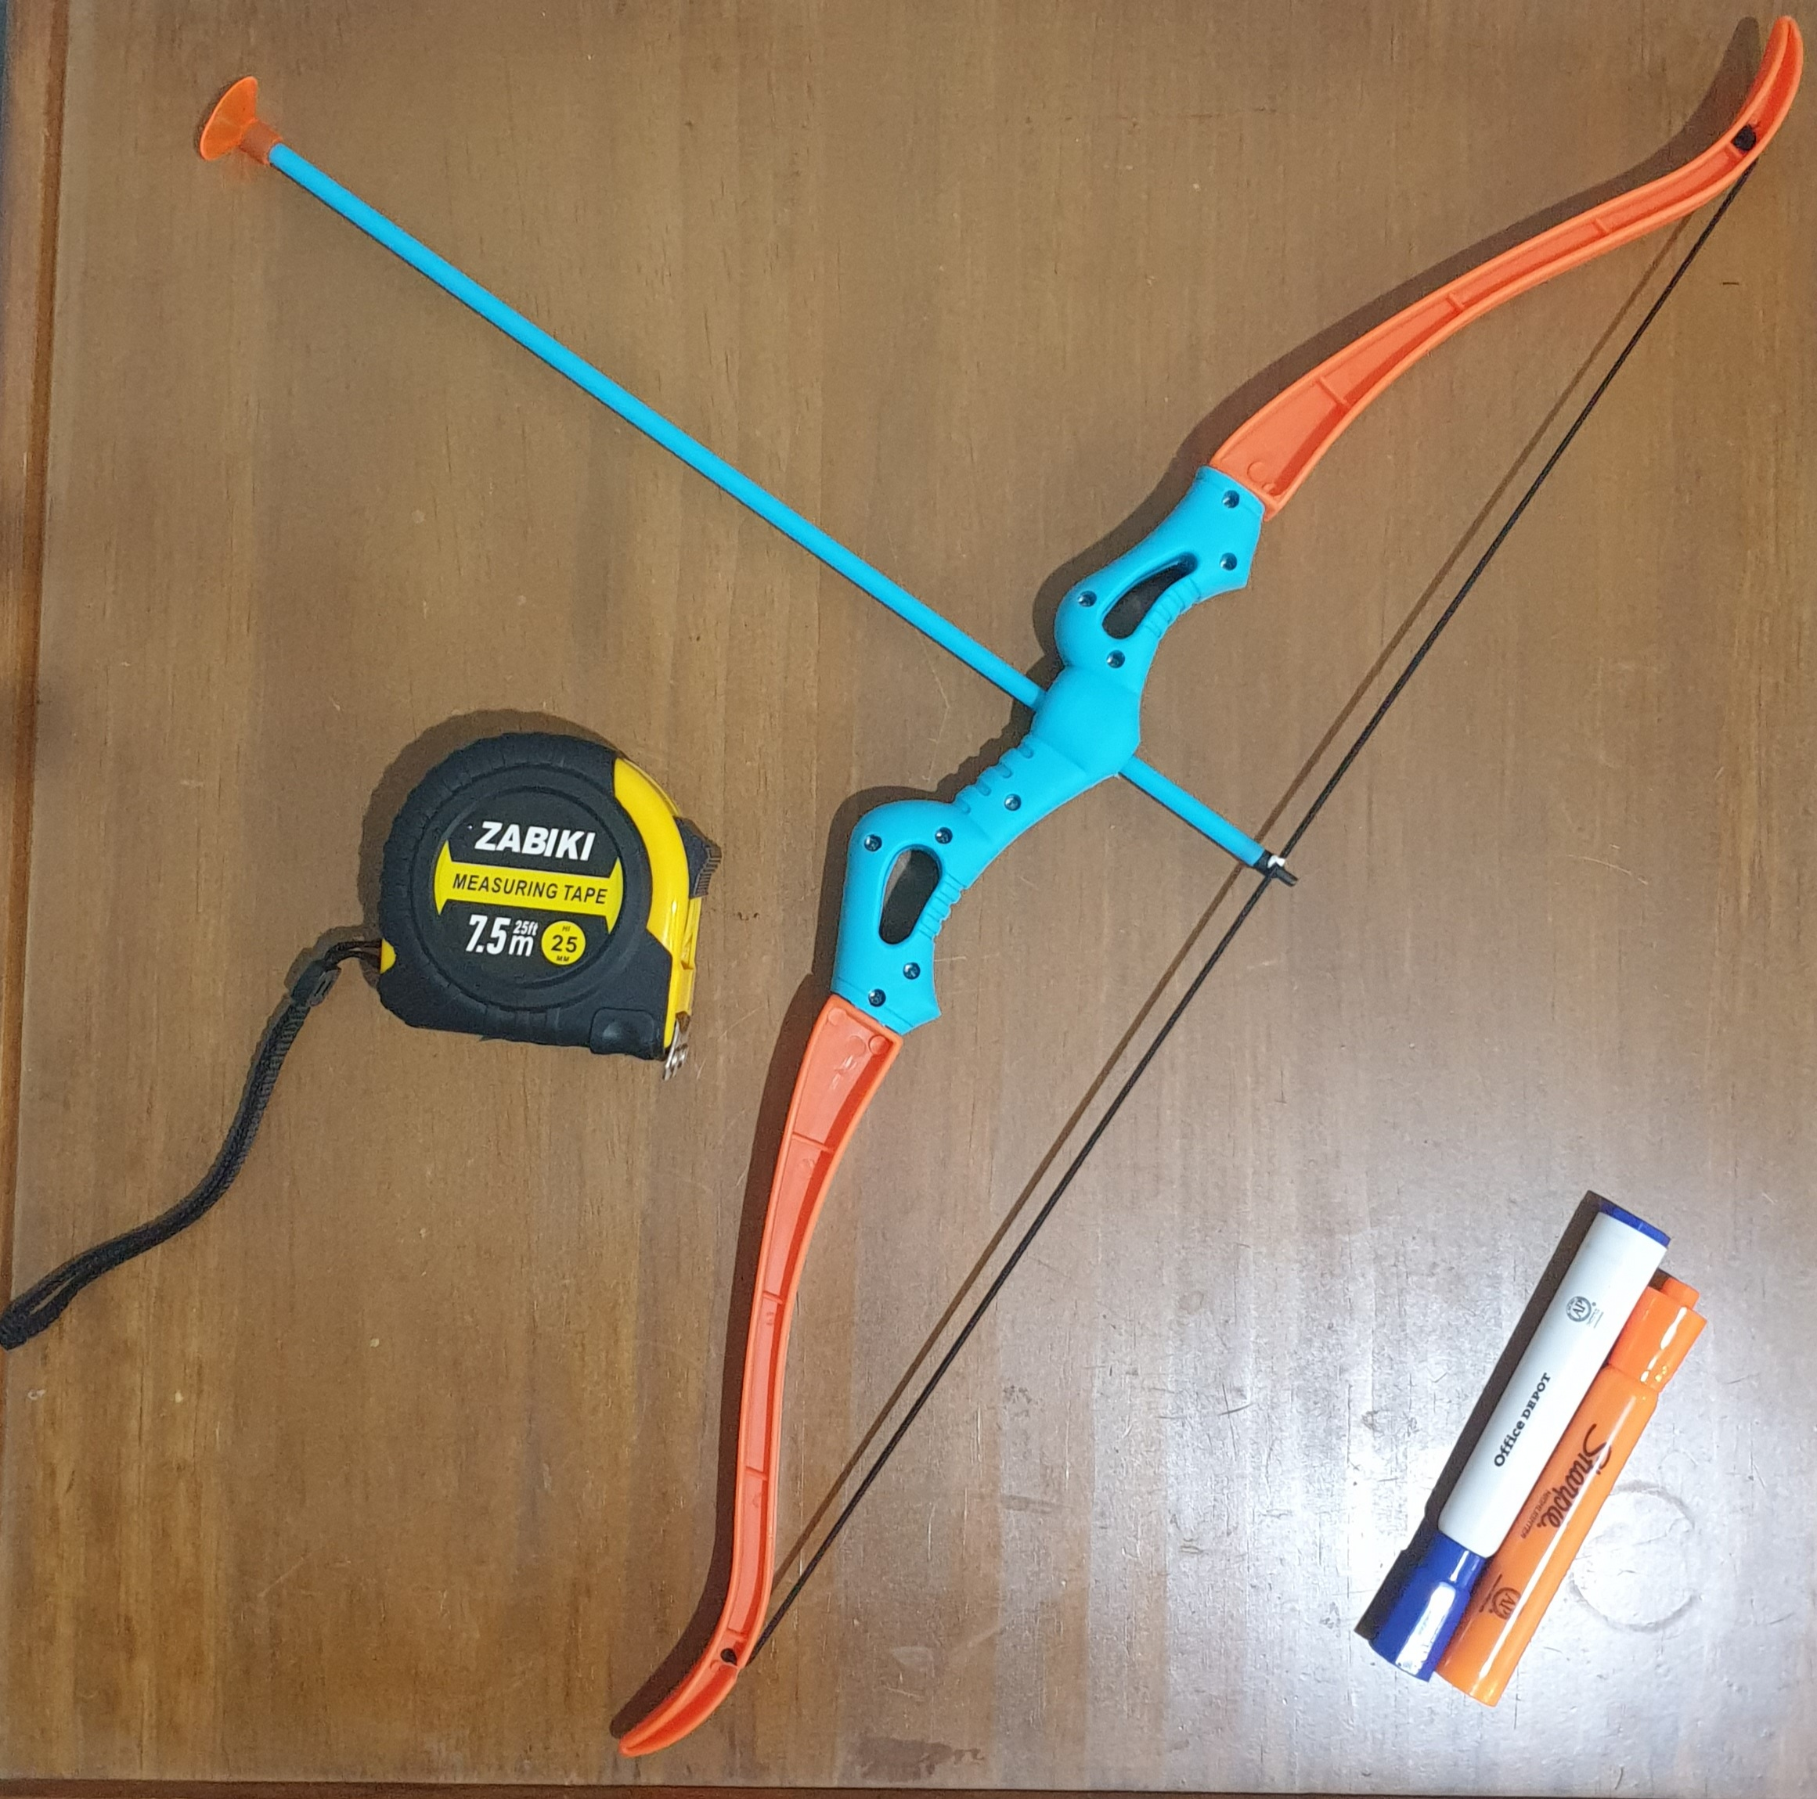
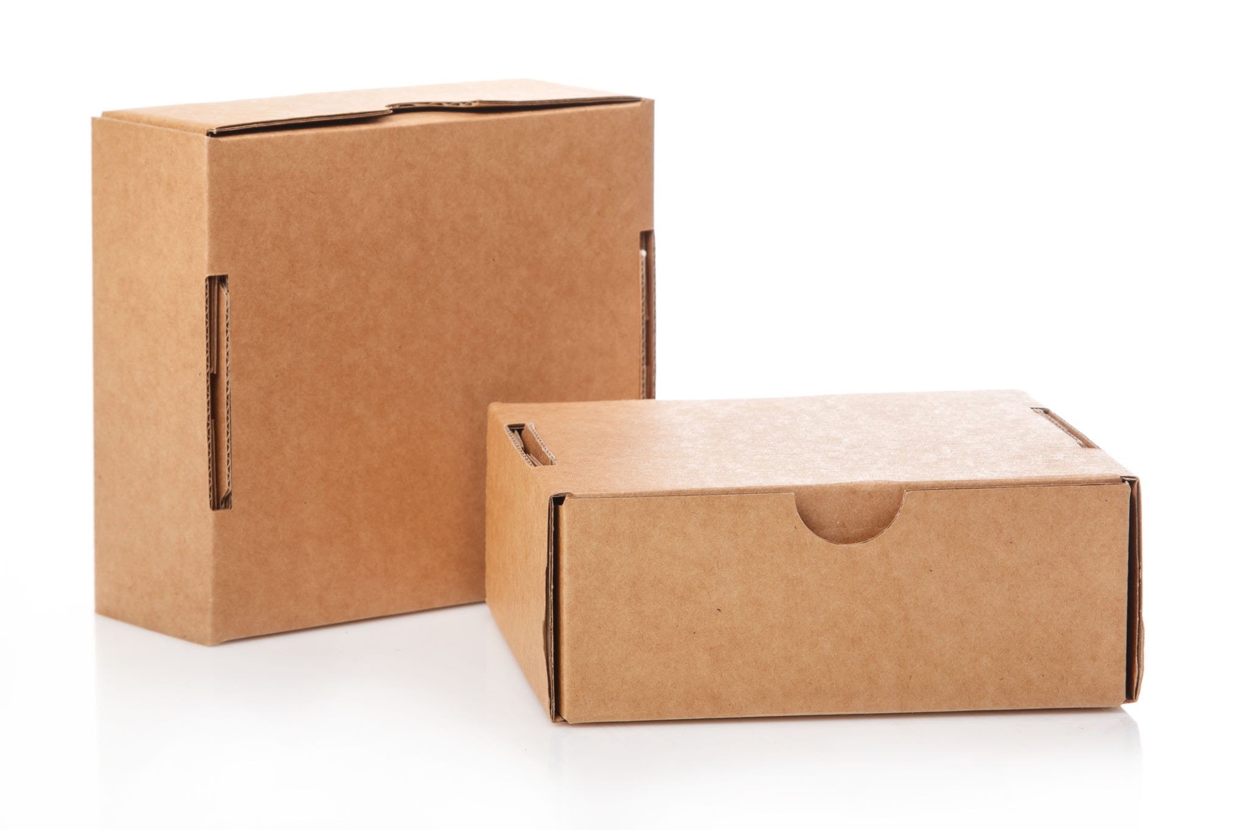
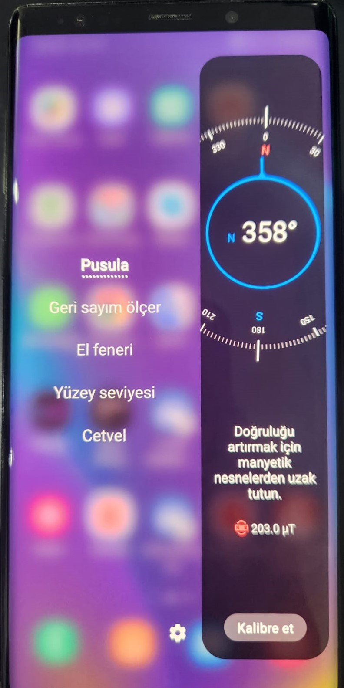
Materials
1. Arrow
2. Measuring tape (7.5 m)
3. Note paper
4. Orange and blue board marker
5. A big cardboard
6. A smart phone with compass

Slide 5
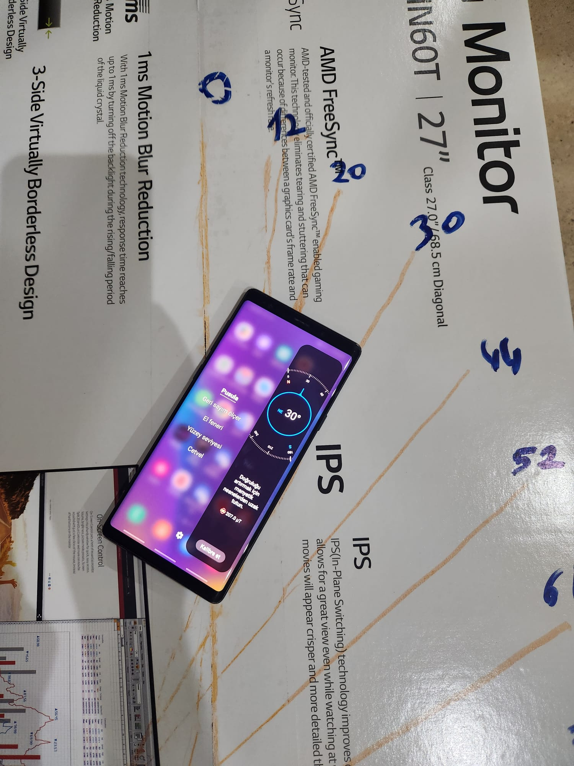
Procedure
I drew lines on cardboard with different angles.
I used smart phone compass program to calculate angles of the lines.

Slide 6
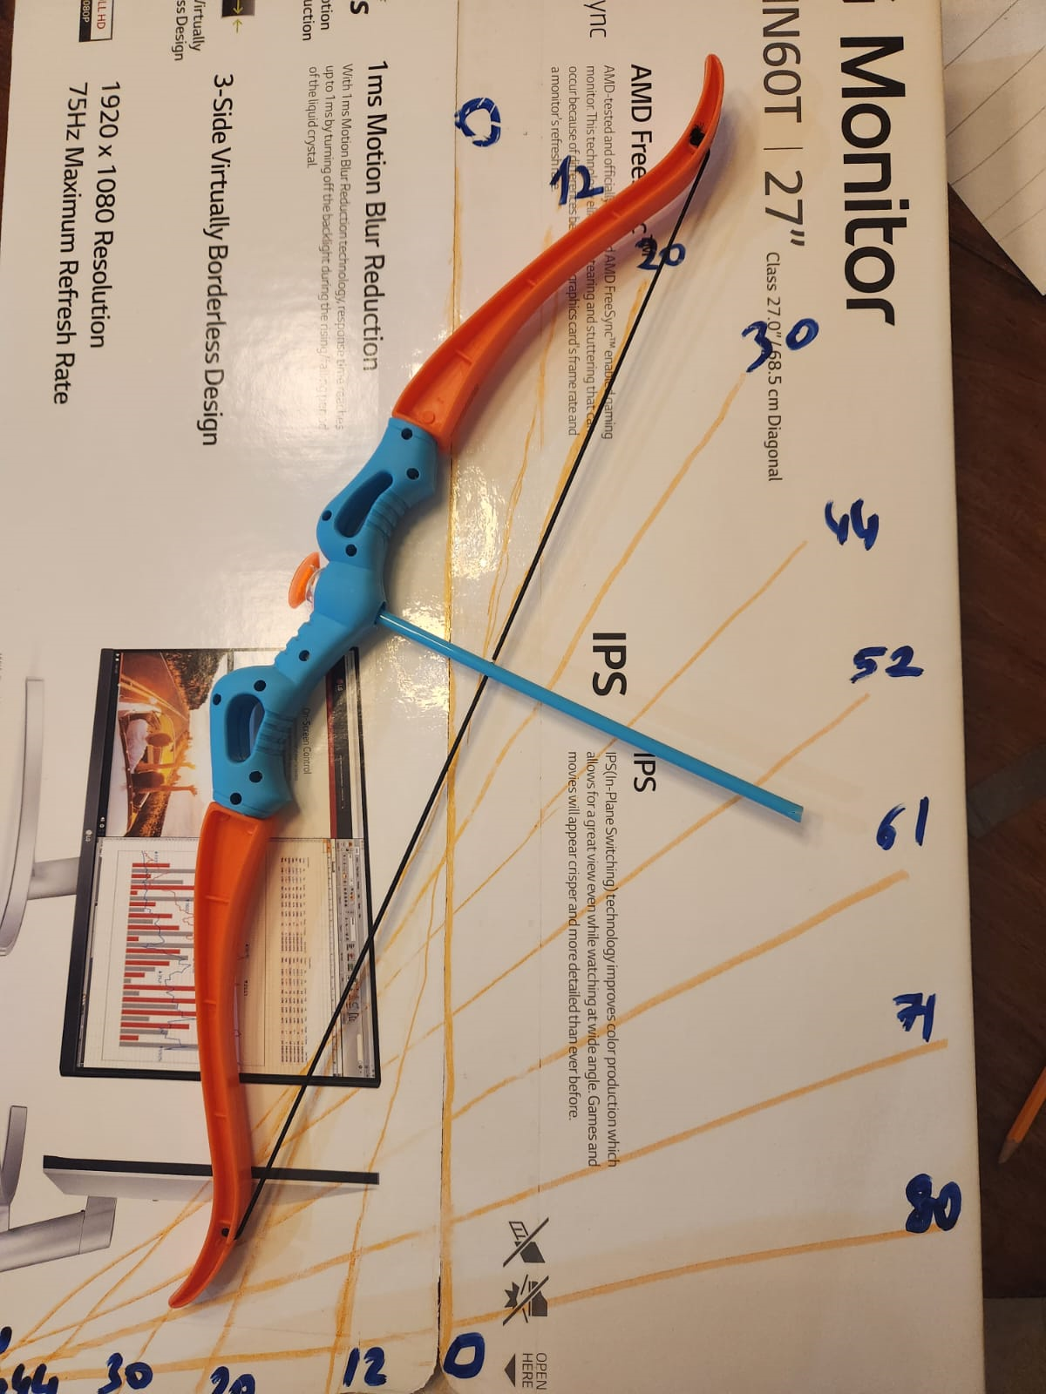
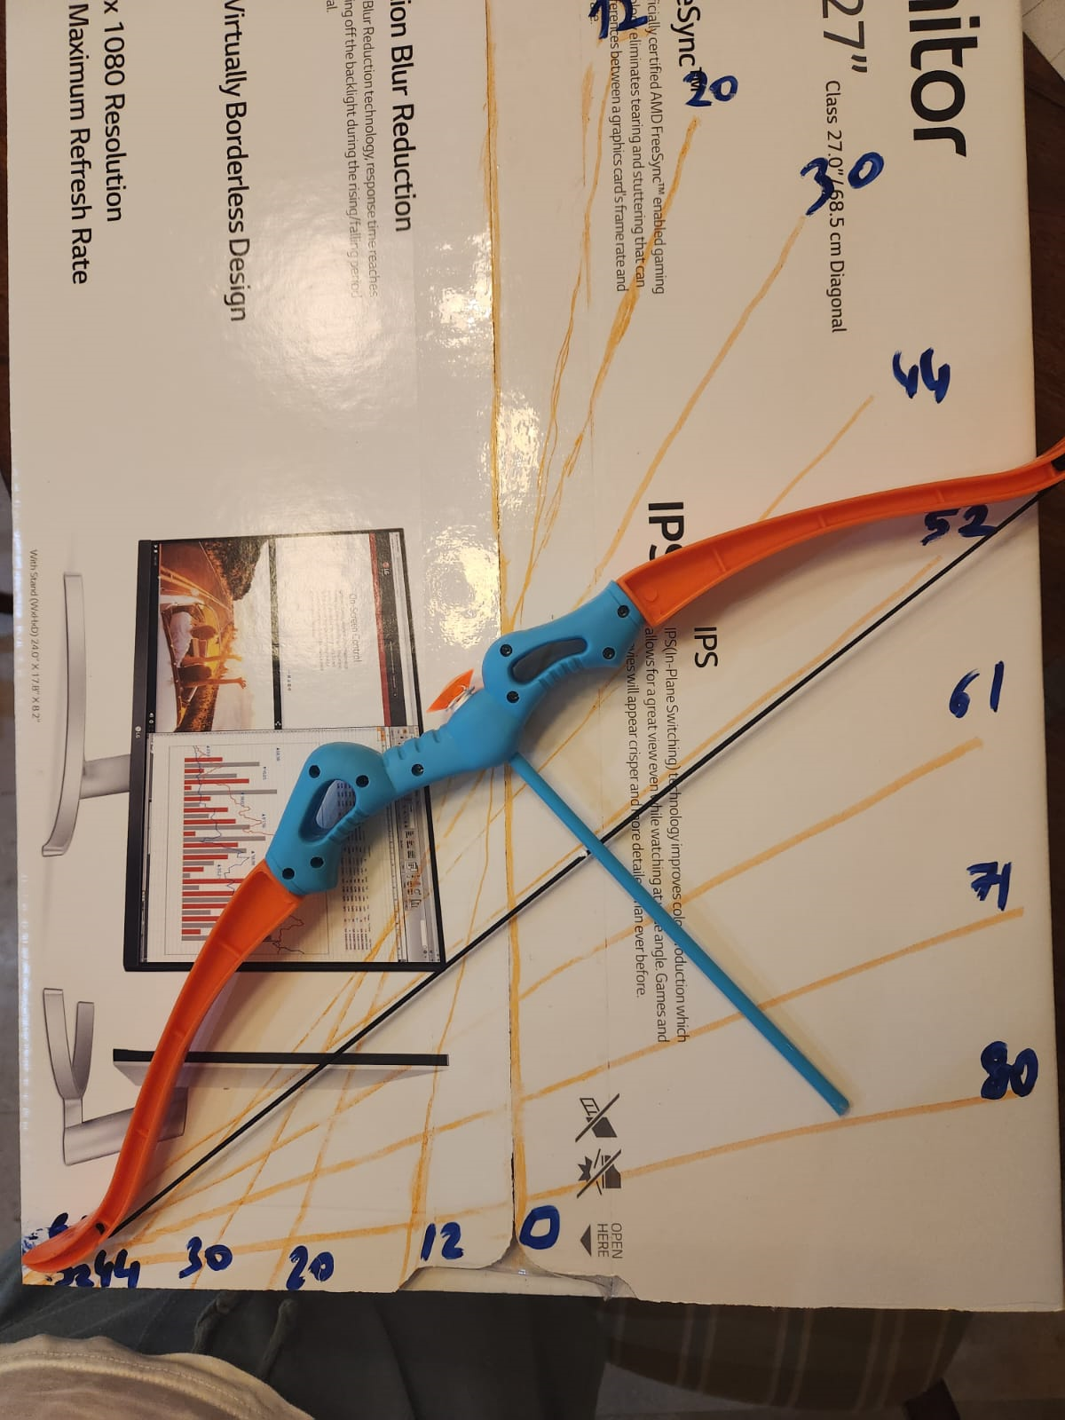
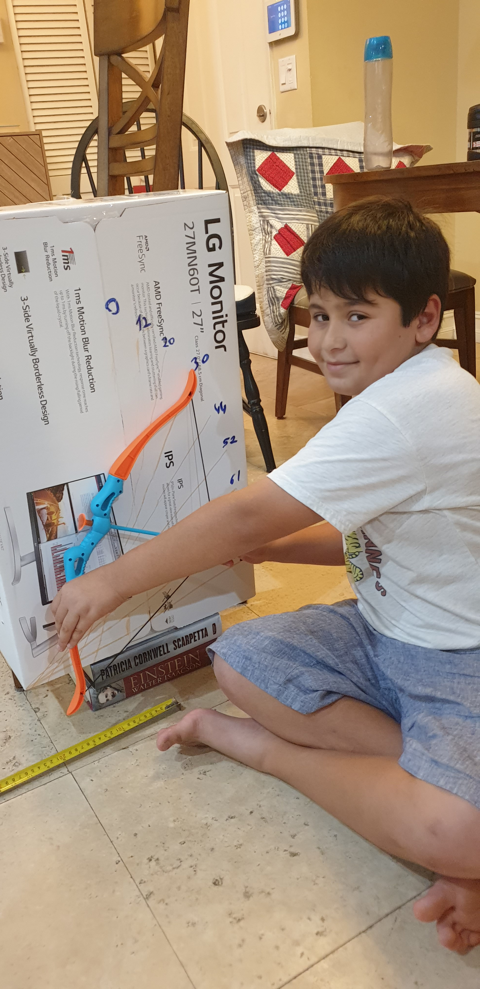
I stretched the arrow to the maximum and threw it from lines of different angles.

Slide 7
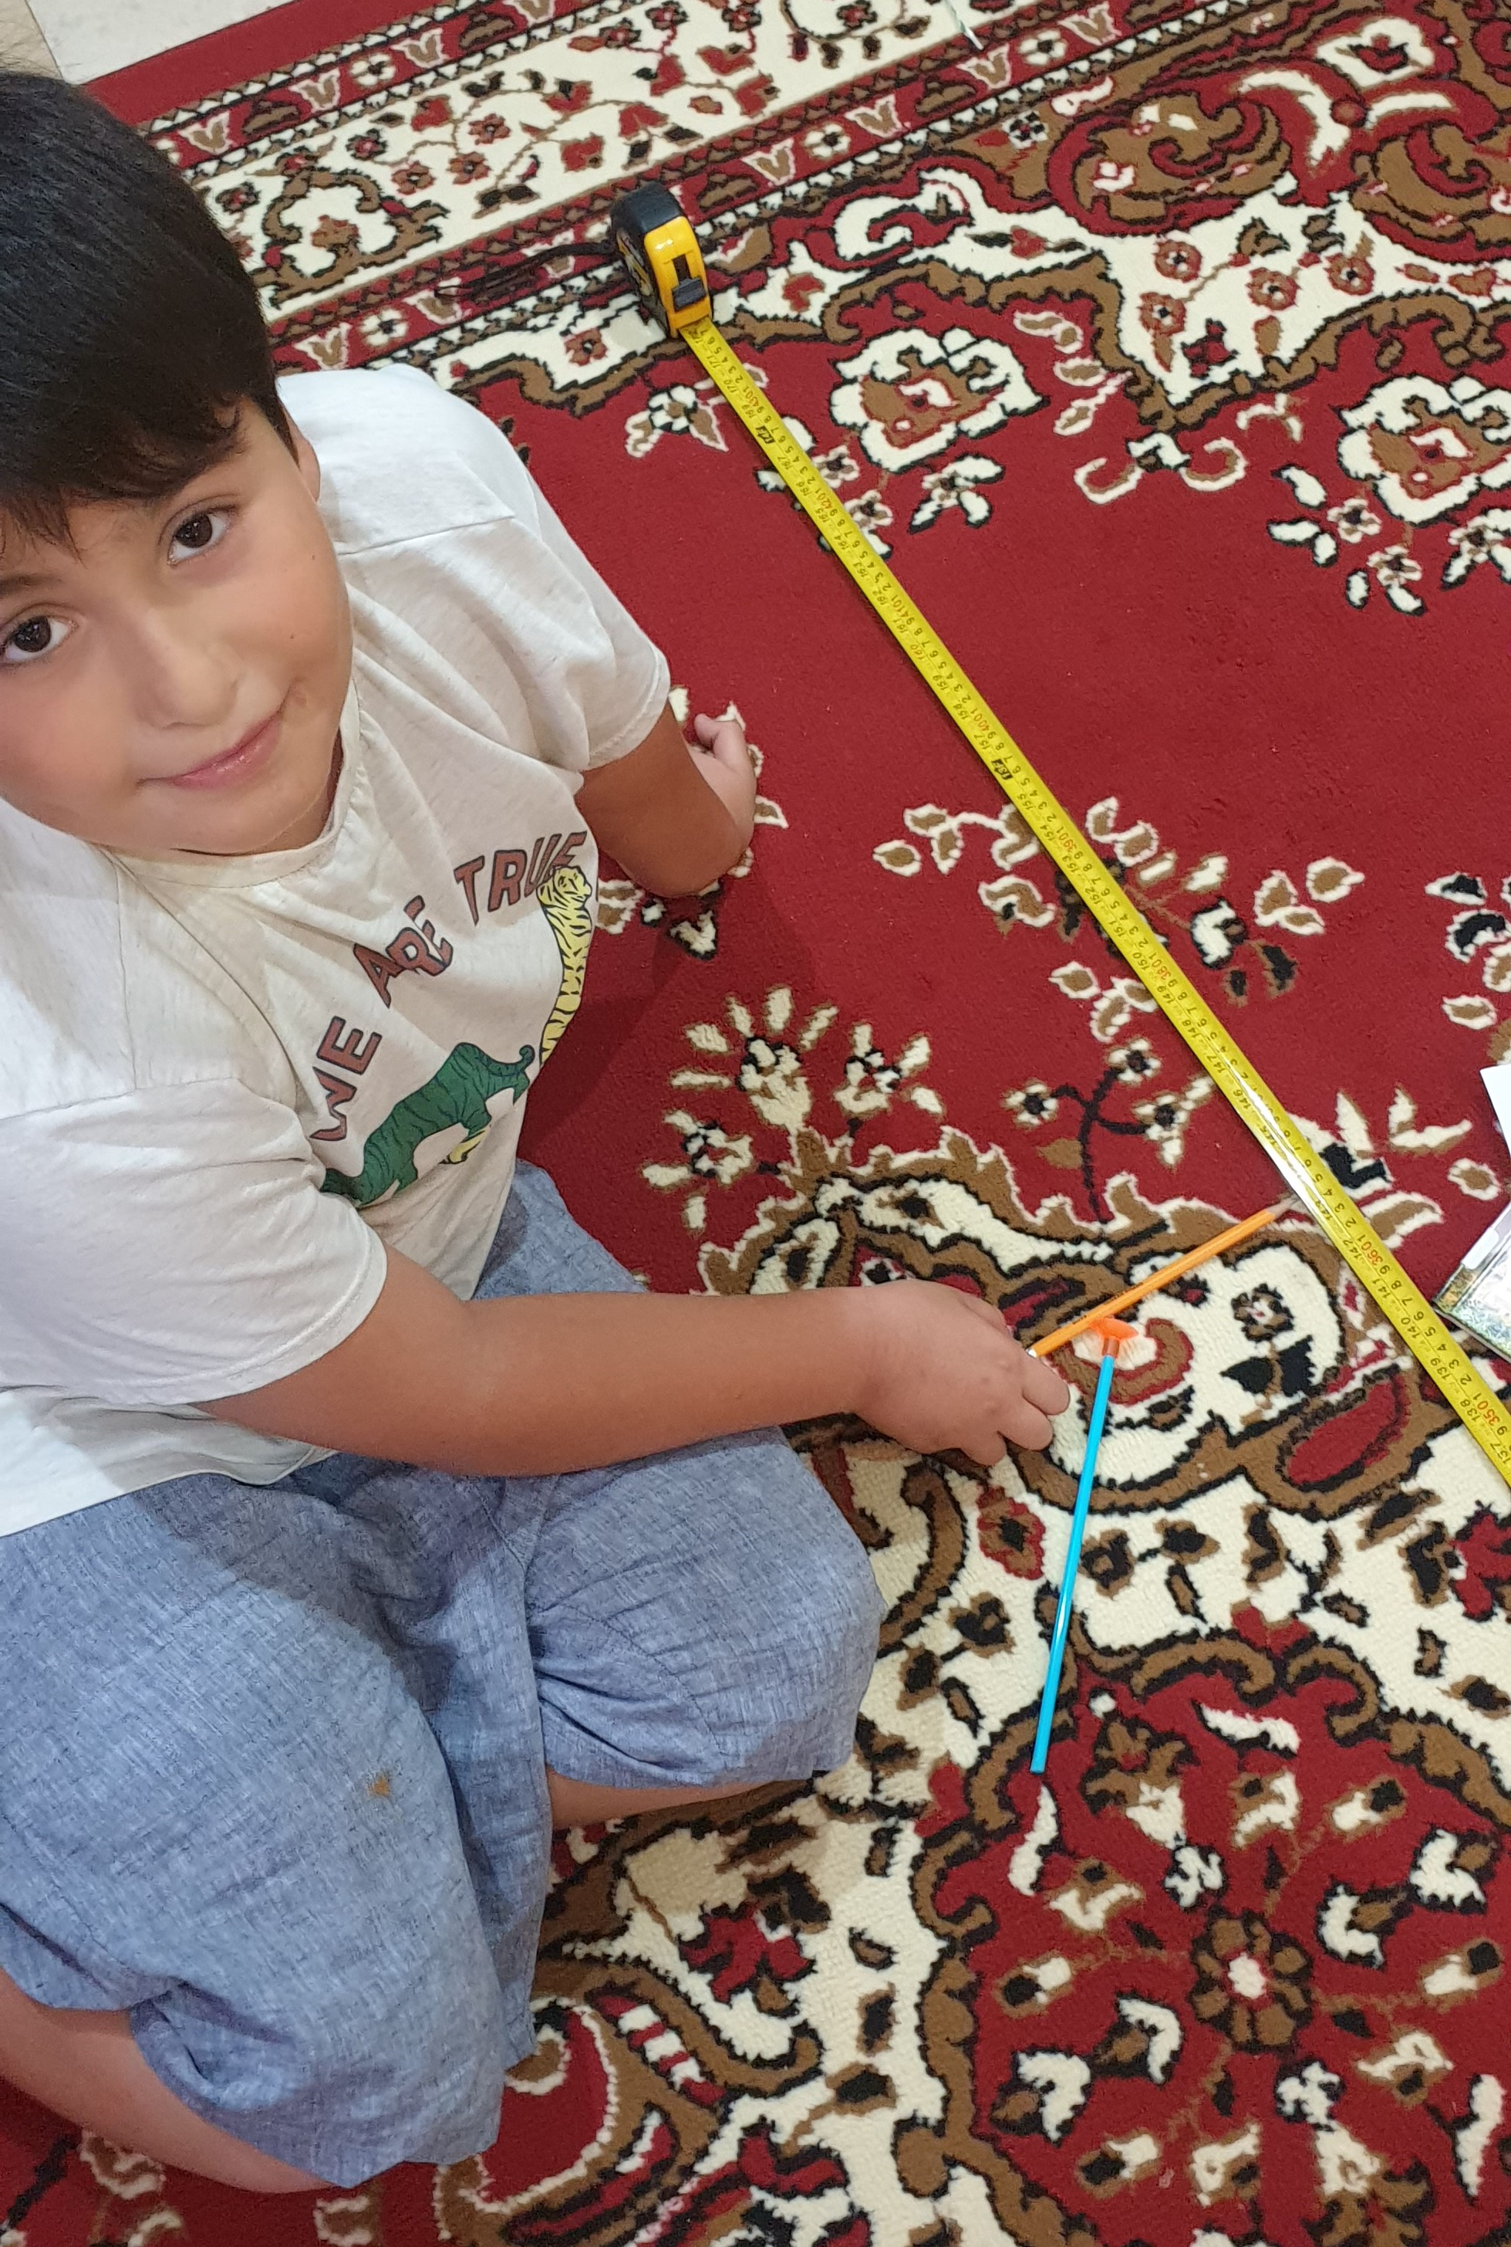
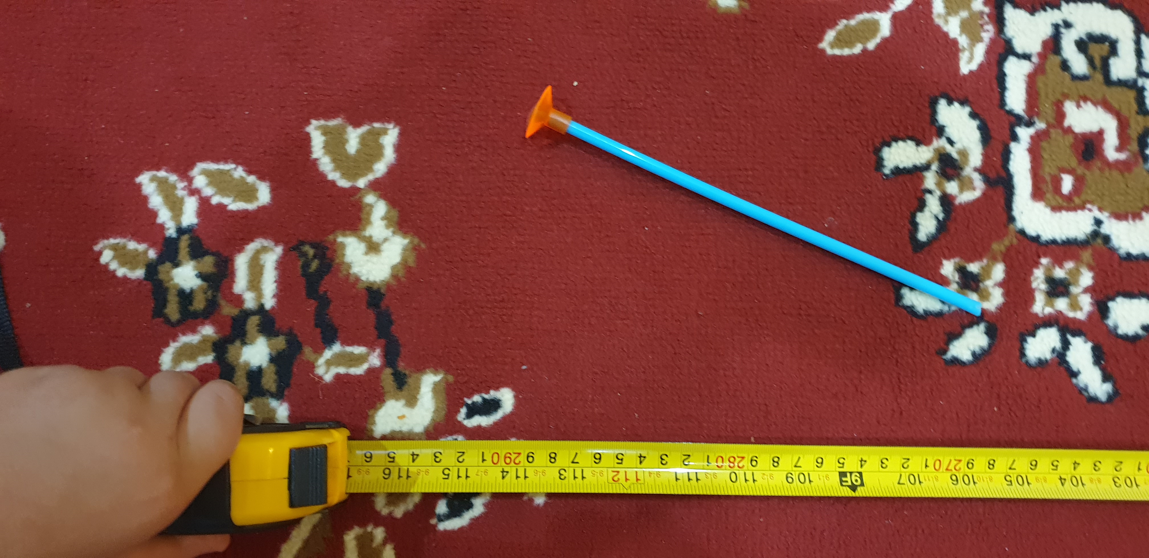
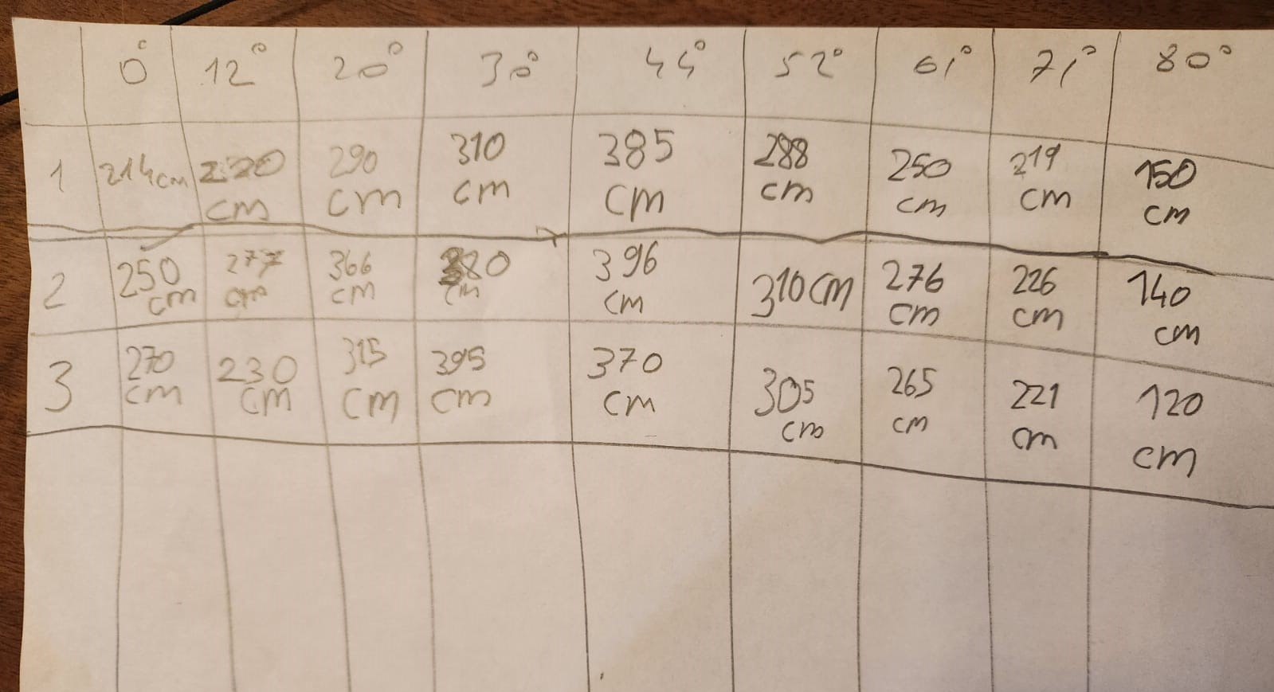
Procedure
I recorded the distances the arrow traveled.
I made 3 attempts for each angle.

Slide 8
Data
Try/ Angle(degree) | 0 | 12 | 20 | 30 | 44 | 52 | 61 | 71 | 80
#1 | 214 cm | 220 cm | 290 cm | 310 cm | 385 cm | 288 cm | 250 cm | 219 cm | 150 cm
#2 | 250 cm | 277 cm | 366 cm | 380 cm | 396 cm | 310 cm | 276 cm | 226 cm | 140 cm
#3 | 270 cm | 230 cm | 315 cm | 395 cm | 370 cm | 305 cm | 265 cm | 221 cm | 120 cm
max | 270 cm | 277 cm | 366 cm | 395 cm | 396 cm | 310 cm | 276 cm | 226 cm | 150 cm

Slide 9
Conclusion
We reached the farthest distance when we shot at 44 degree.

Slide 10
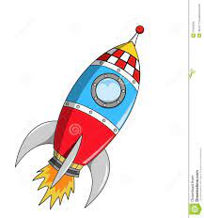
Real Life Connection
This information will be useful to us when we are throwing stones away and sending rockets into space. ☺

